Slide 1
CS 5402 Introduction to Data Mining
Data Mining Methods - Support Vector Machine
v.1.0
Perry B. Koob, koobp@mst.edu

Slide 2
What we are going to learn.
Support Vector Machine

Slide 3
Support Vector Machines
Boser, B. E., Guyon, I. M., & Vapnik, V. N. (1992, July). A training algorithm for optimal margin classifiers. In Proceedings of the fifth annual workshop on Computational learning theory (pp. 144-152).
Support Vector Machine is a Supervised Learning, Binary Classifier designed to maximize the distance between a hyperplane that divides two linearly separable groups of data and the Support Vector that represents the boundary of the two data groups utilizing a Kernel function.

Slide 4
Support Vector Machines
Boser, B. E., Guyon, I. M., & Vapnik, V. N. (1992, July). A training algorithm for optimal margin classifiers. In Proceedings of the fifth annual workshop on Computational learning theory (pp. 144-152).
Support Vector Machine is a Supervised Learning, Binary Classifier designed to maximize the distance between a hyperplane that divides two linearly separable groups of data and the Support Vector that represents the boundary of the two data groups utilizing a Kernel function.

Slide 5
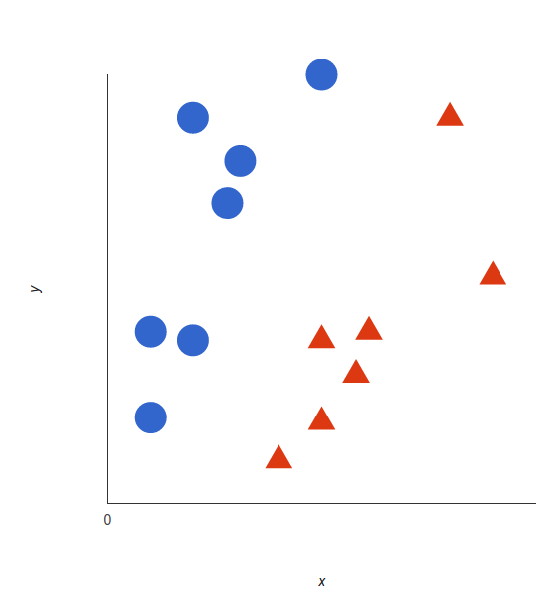
Support Vectors
https://monkeylearn.com/blog/introduction-to-support-vector-machines-svm/

Slide 6
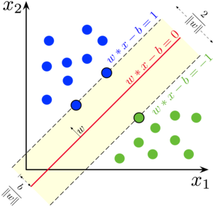
Support Vectors
https://en.wikipedia.org/wiki/Support-vector_machine

Slide 7
Support Vectors
Margin
https://en.wikipedia.org/wiki/Support-vector_machine

Slide 8
Support Vectors
Support Vectors
https://en.wikipedia.org/wiki/Support-vector_machine

Slide 9
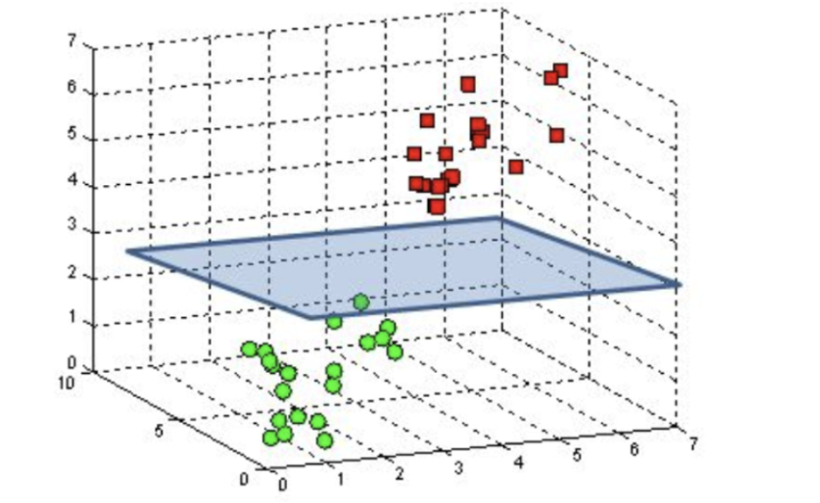
Support Vector Machine?
https://developer.xilinx.com/en/articles/exploring-support-vector-machine-acceleration-with-vitis.html

Slide 10
Support Vector Machines with Benefits
SVM uses the Support Vectors to calculate decisions instead of the entire training data set, making it more efficient.
SVM is effective in high dimensional spaces. Most algorithms start to have difficulty with high dimensional spaces because of the calculation involved. Since we only use the support vectors for calculations, SVM can handle more dimensions than other algorithms.
SVM works when there are more dimension than samples, so it is commonly used in text mining.

Slide 11
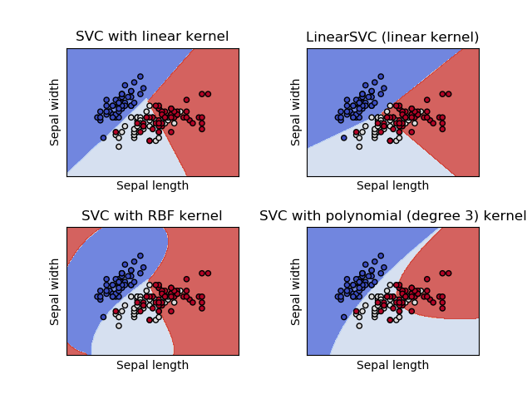
SVM Options
Kernel Functions
SVM can use different Kernel functions.
Normally a Linear Kernel is used, but can also use Polynomial Kernels and Radial Basis Function Kernels.
https://scikit-learn.org/stable/modules/svm.html

Slide 12
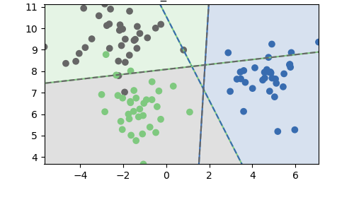
SVM Options
Multi-Class
SVM can be used to train Multi-Class data using the one-vs-one, or pairwise approach.
https://scikit-learn.org/stable/modules/svm.html

Slide 13
SVM Options
Multi-Class
SVM can be used to train Multi-Class data using the one-vs-one, or pairwise approach.
A
C
B
https://scikit-learn.org/stable/modules/svm.html

Slide 14
SVM Options
SVM 2 between B and C
Multi-Class
SVM can be used to train Multi-Class data using the one-vs-one, or pairwise approach.
A
C
SVM 1 between A and B
B
SVM 3 between A and C
https://scikit-learn.org/stable/modules/svm.html

Slide 15
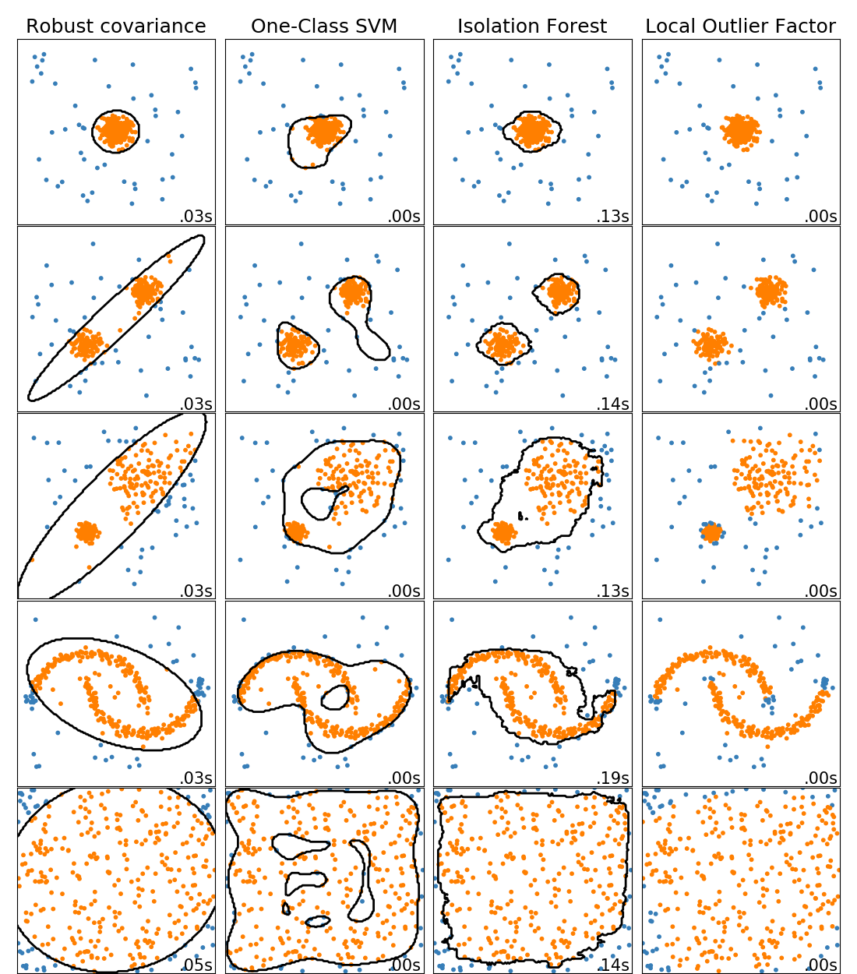
SVM Variants
Linear Support Vector
One-Class Support Vector Machine
Support Vector Regression
Bayesian Support Vector Machine
https://scikit-learn.org/stable/modules/outlier_detection.html#outlier-detection

Slide 16
SVM R and Python
R
svm function in the e1071 package
https://cran.r-project.org/web/packages/e1071/vignettes/svmdoc.pdf
model <- svm(x, y)
Python
svm function in SciKit Learn
https://scikit-learn.org/stable/modules/svm.html
model = svm.SVC()
model.fit(X, y)

Slide 17
What we covered.
Support Vector Machine

Slide 18
References
Shmueli, G., Bruce, P. C., Yahav, I., Patel, N. R., & Lichtendahl Jr, K. C. (2017). Data mining for business analytics: concepts, techniques, and applications in R. John Wiley & Sons.
Witten, I. H., Frank, E., Hall, M. A., & Pal, C. J. (2016). Data Mining: Practical Machine Learning Tools and Techniques.

